Slide 1
Venous throboembolic disease
Dr mazin A Hazza

Slide 2
objective
To know the RF for DVT and pulmonary embolisim
How to diagnose
mangement

Slide 3
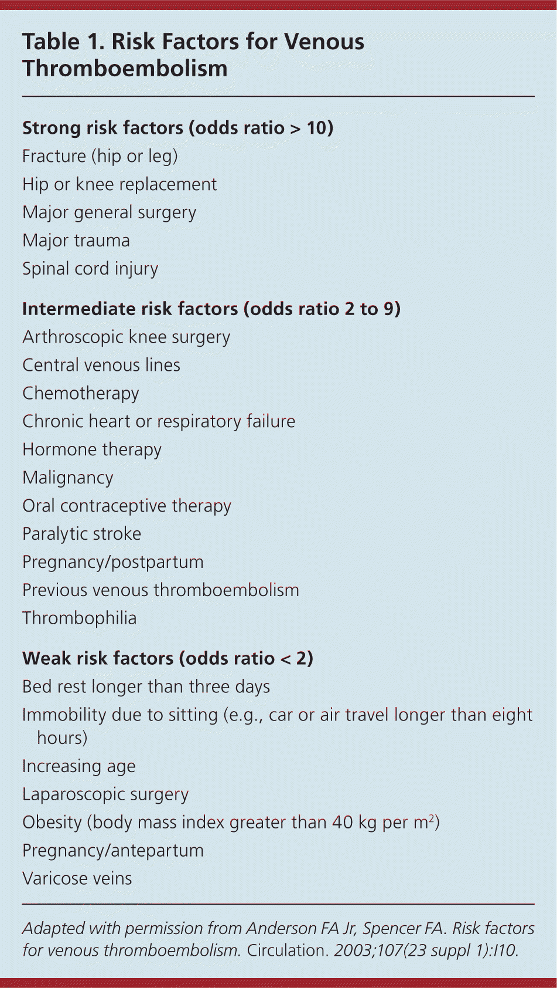

Slide 4
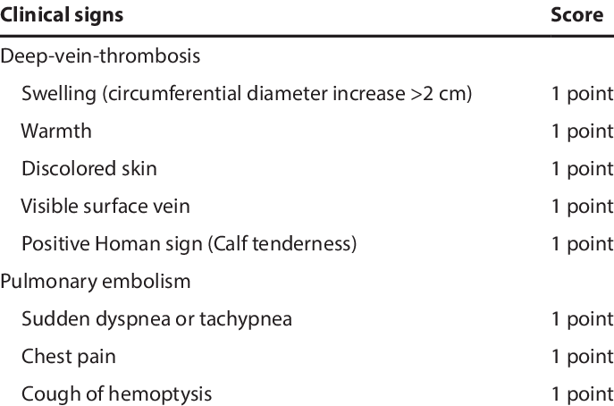

Slide 5
Dx
D dimer
ECG
Echo
Doppler
CT angiography
CXR
V/P matching

Slide 6
Treatment
Heparin
Warferin
revaroxiban

